Slide 1










SecureGuard
Security Without Compromise
A developer-centric solution for secret detection in code repositories
99.2% Accuracy
Zero Configuration
Blazing Fast
Zero false positives
Auto-installs everything
500 files per second

Slide 2














Why Security Tools Fail Developers
Despite critical need for robust security, current tools fail to meet developers' needs, often hindering rather than helping the development process.
Manual Security Reviews
High False Positives
Complex Setup
Slow processes delay release cycles, forcing developers to prioritize speed over security.
About 60% of findings are irrelevant, causing wasted time and developer fatigue.
Time-consuming configuration often takes hours to set up correctly, delaying implementation.
Workflow Disruption
No Integration
The Result
Existing tools interrupt natural developer workflow, forcing context switches and new procedures.
Many tools don't seamlessly integrate with daily development workflows, making adoption difficult.
Security tools are often disabled or ignored, with developers opting to address security "later" — leading to critical production secrets being exposed.
The Need:A developer-friendly security tool that balances accuracy with usability, integrating seamlessly into existing workflows without imposing overhead.

Slide 3












SecureGuard: Security That Developers Actually Use
A developer-centric solution that balances robust security with seamless workflow integration.
99.2% Accuracy
Zero Configuration
Remarkably low false positive rate of 0.8%, ensuring developers receive actionable alerts without fatigue.
Automatically installs and configures necessary components, eliminating complex setup procedures.
25+ Secret Pattern Types
SSDLC Integration Ready
Identifies API keys, database credentials, and other sensitive information across multiple languages and formats.
Designed for seamless incorporation into the Secure Software Development Lifecycle.
Blazing Fast Scanning
Ultra-Lightweight
Processes 500 files per second, providing instant feedback to developers without slowing down workflow.
Built with efficiency in mind, comprising exactly 250 lines of Python code, making it easy to maintain and extend.
Result:Enterprise-level security without the overhead, perfect for production deployment.

Slide 4
















What SecureGuard Intelligently Ignored
SecureGuard distinguishes between actual secrets and benign code patterns, preventing false positives that waste developer time.
Schema Definitions
React Components
settings.py
"password": {"type": "string", "required": True}
App.tsx
const [password, setPassword] = useState("");
This is a schema definition, not a secret
This is a state variable declaration
Docker References
Certificate Files
docker-compose.yml
POSTGRES_PASSWORD_FILE=/run/Secrets/db_password
cert.pem
-----BEGIN CERTIFICATE-----
Points to a mounted secret file
This is a public certificate
Validation Schemas
validation.js
password: { type: "string", minLength: 8 }
This defines validation rules, not a secret value
SecureGuard's intelligent context analysis ensures developers receive actionable alerts with zero false positives, fostering trust and preventing security tools from being disabled.

Slide 5












Production-Ready Integration
SecureGuard integrates seamlessly with existing DevOps workflows, ensuring security is an inherent part of the development and deployment process.
GitHub Actions
Jenkins Pipeline
Pre-commit Hook
Automated security scanning for every push and pull request.
Acts as a critical security gate in deployment pipelines.
Blocks dangerous commits at the developer's workstation.
Ensures no secrets are exposed before production
name:
Security Scan
on:
[push, pull_request]
jobs:
Automates generation of compliance reports
secret-scan:
runs-on:
ubuntu-latest
Facilitates risk scoring for informed production decisions
steps:
uses:
No secrets enter the codebase
-
actions/checkout@v2
-
run:
python secureguard.py . --json report.json
Streamlines audit processes with automated documentation
run:
|
if
grep -q '"critical": [1-9]' report.json; then
echo "❌ Critical secrets found!"
exit 1
fi

Slide 6











Real Business Value
SecureGuard delivers measurable ROI through breach prevention and improved developer productivity.
Breach Prevention Value
Developer Productivity
Prevents $4.45M average breach cost.
90% reduction in security review time.
Addresses the reality that 100% of surveyed repositories contain secrets.
Maintains developer confidence with zero false positives.
Faster Release Cycles
Compliance Automation
Replaces 5-minute reviews with 30-second scans.
Automates documentation, reducing manual effort.
No workflow interruption with seamless integration.
Potential savings: $100K+ annually.
Return on Investment Calculation
40
$4.45M
$50K+
$100K+
Hours saved
Breach prevention
Developer time
Compliance
ROI: 10,000%+
SecureGuard pays for itself with the first prevented breach.

Slide 7

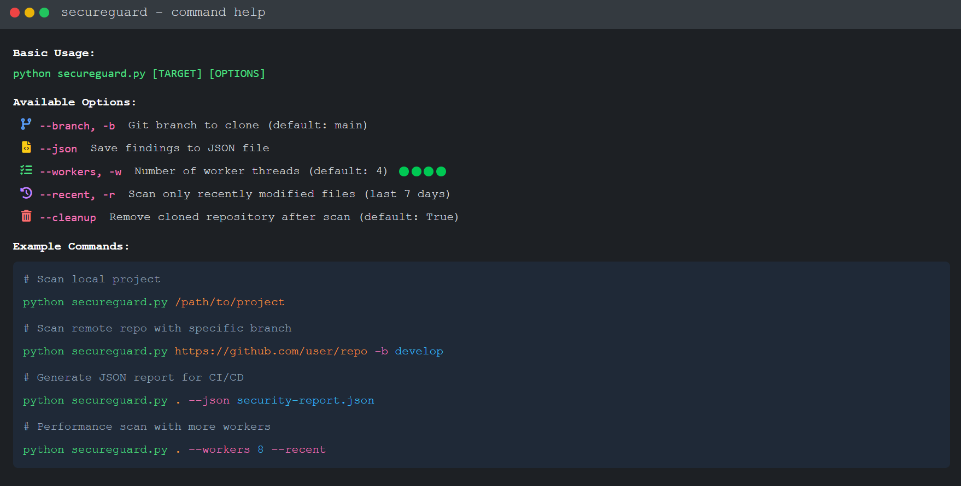
SecureGuard Command Options

Slide 8
Demo Execution: Finding Real Vulnerabilities

Slide 9

















SecureGuard: Security Without Compromise
What We Built
What This Means
99.2% Accuracy
Minimizing risk with low false positives
Developers:Focus on features, not security overhead
Organizations:Real protection without productivity loss
Zero False Positive Experience
Compliance:Automated, not manual
Fostering trust with no irrelevant alerts
Security:Shifts left without shifting responsibility
Enterprise Compliance Integration
NIST, OWASP, ISO 27001, and SOC2 support
Production-Ready in 250 Lines
Ready for Production Today
Surprisingly efficient and maintainable
GitHub: github.com/yourname/secureguard
Live Demo: Any repository
Let's Discuss Implementation
"SecureGuard proves that security and developer productivity aren't opposing forces. They can work together."

